Slide 1
SOLUTION DECK
Predicting High Tumor Mutational Burden in Cancer Patients

Slide 2





AGENDA
Defining The Problem
Exploratory Data Analysis
Modeling
Data Visualization
Recommendations

Slide 3



Problem Understanding
The primary issue is a significant time involved in predicting cancer patients with high tmb status which directly affects the patient participation and trial costs. This decline in number of patients will poses a threat to clinical trail process and will affect in long run.
The goal is to predict which cancer patients have a high Tumor Mutational Burden (TMB) based on available clinical data. TMB refers to the number of mutations per megabase of DNA within a tumor and is used as a biomarker to predict how likely a tumor is to respond to immunotherapy.
By highlighting promising samples among many, the clinical trial team can prioritize testing, reducing time and avoiding unnecessary false tests. This efficiency accelerates insights into patient suitability for immunotherapy and facilitates informed decisions for targeted treatments, optimizing trial outcomes.

Slide 4

PROBLEM STATEMENT | Prediction of Cancer Patients with High TMB.
SITUATION : CURRENT STATE
OBVIOUS GAP
DESIRED FUTURE STATE
Key Stakeholders and their Responsibilities
The clinical trials team of a pharmaceutical company is the one who ensures that the trial is conducted safely and in compliance with regulatory standards.
Current Scenario
Identifying Tumor Mutational Burden (TMB) is challenging because current testing procedures are time-consuming and costly, making it difficult for patients to access testing.
Purpose
The time and costs associated with direct TMB testing are considerably high.
The time required for Tumor Mutational Burden (TMB) calculations often leads patients to avoid the test, and these trials also incur significant costs.
Analytical Output:
By utilizing genetic profiles, the pharmaceutical company will be able to accurately identify and target patients for personalized treatments.
Utilization of Output
By leveraging machine learning, the clinical trial team will streamline the identification process for patients with high TMB, thereby reducing the number of tests required.
Required Input
To predict patients with high TMB, we need their demographics, biomarkers, lab results, vital signs, Whole Genome Sequencing (WGS) data, tumor Characteristics, lifestyle factors
QUESTIONS
Does the addition of computational tools decrease the time taken for tmb testing?
Does integration of modern technology reduce overall costs?

Slide 5





Executive Summary
Problem Statement: The goal is to predict patients with high tmb status so that they can streamline the patient selection.
PDNA
It is illustrated for easy interpretation of various aspects. This acts as a building block for all business decisions.
Dashboard
The clinical trail team can identify high tmb patients, evaluate biomarkers and guide precision treatment strategies efficiently.
Recommendations
Recommendations are given based on the analysis and insights.
Problem Understanding
Understanding the problem statement to identify the key factors that affects tmb status and pros and cons of current methodology used in clinical trials.
EDA
MODELING
Data analysis is done to understand the data and also find the key factors that may be used to predict tmb status.
Modeling is done to make the classification of patients based on previous data.

Slide 6







DETAIL VIEW | Data pre-processing & EDA
DATASET COLLECTION
EDA & FEATURE ENGINEERING
Problem definition and hypothesis construction
IDENTIFYING LEVEL
OF THE DATA
EDA & FEATURE ENGINEERING
Merged Data
Demographics
Analyzing the relevant data as features which can be used to test our hypothesis and prediction.
Univariate Analysis
Bivariate Analysis
Multivariate Analysis
Lab results
Biomarkers
Vital signs
Datasets
Data Collection
Feature Engineering

Slide 7
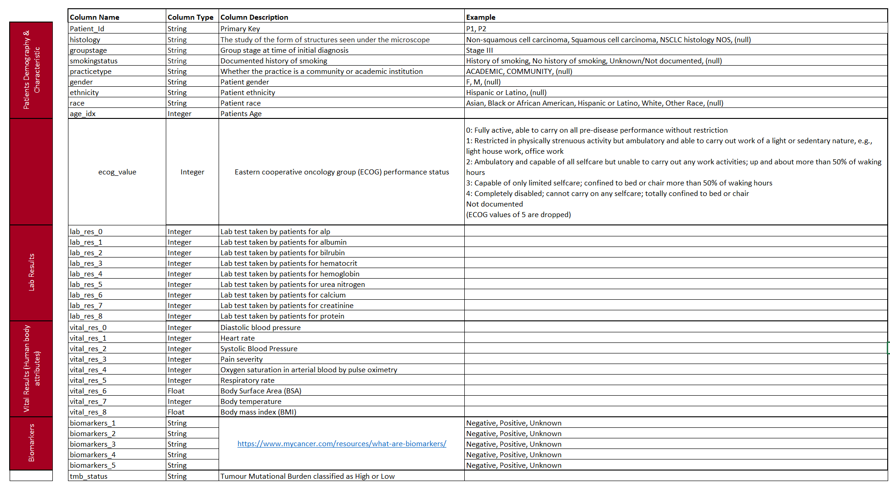
Understanding the data

Slide 8
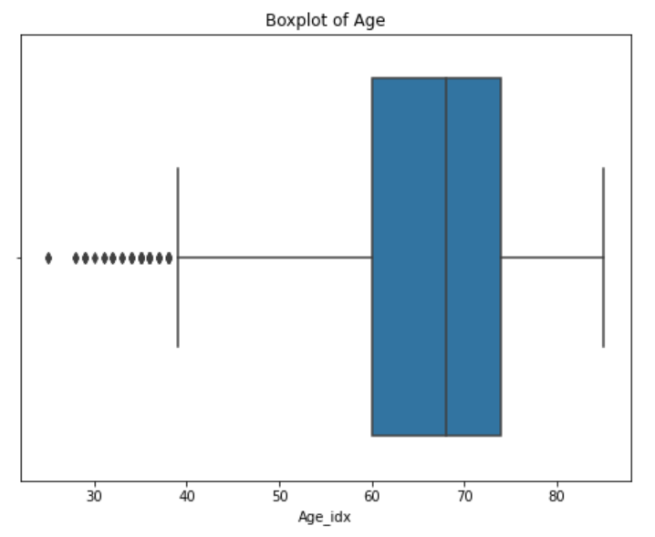
EDA | Outlier Detection
INSIGHTS
There are outliers in age
Feature​ | Age_idx
No. of Outliers | 48
Maximum | 95
Minimum​ | 25
Median(Middle value of the dataset) | 68

Slide 9
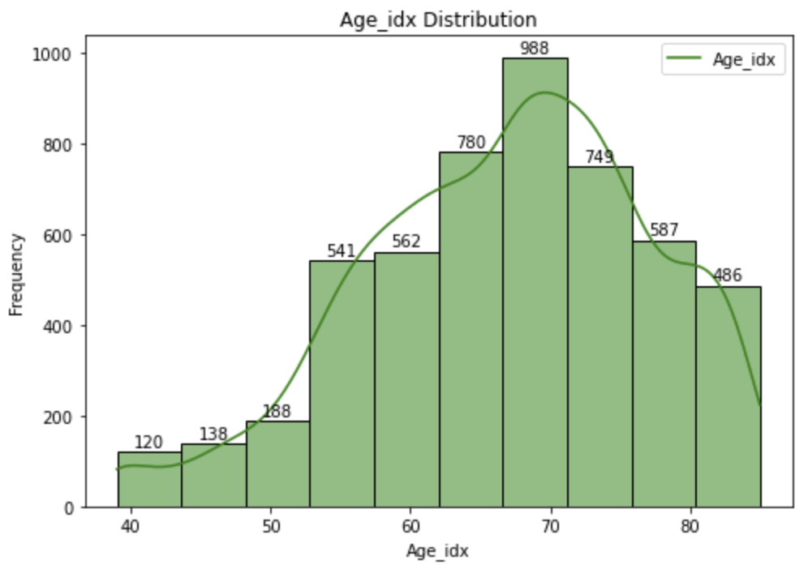
EDA | Univariate Analysis
Mean | Median | Mode
66.72 | 68 | 85
Insights
The data shows that the majority of patients fall within the 60-80 age group, indicating a concentration in this range.
The age distribution is slightly left-skewed, with a skewness value of -0.502.

Slide 10
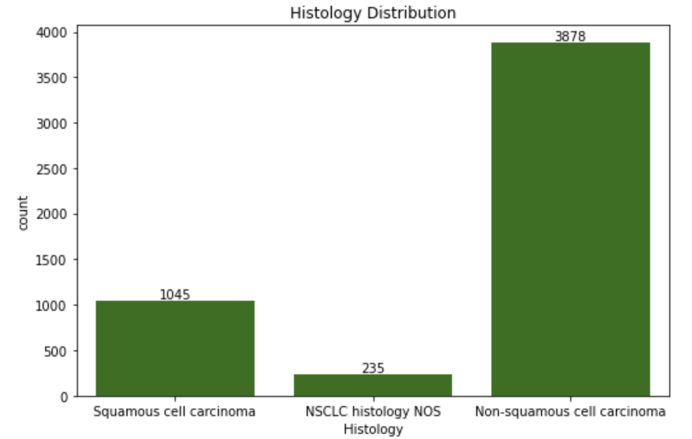
EDA | Univariate Analysis
Insights
Non Squamous is the most common histological type,
with 3878 cases, accounting for 75.2% of the total patients.
Squamous cell carcinoma is present in 1045 patients,
making up 20.3% of the population.
NSCLC histology NOS(Not Otherwise Specified),which is a
less specific classification, is found in 235 patients,
representing 4.6% of the dataset.
This suggests that non-squamous cell carcinoma Is the
predominant cancer type, while squamous cell carcinoma
and NSCLC histology NOS are less common but still significant.

Slide 11
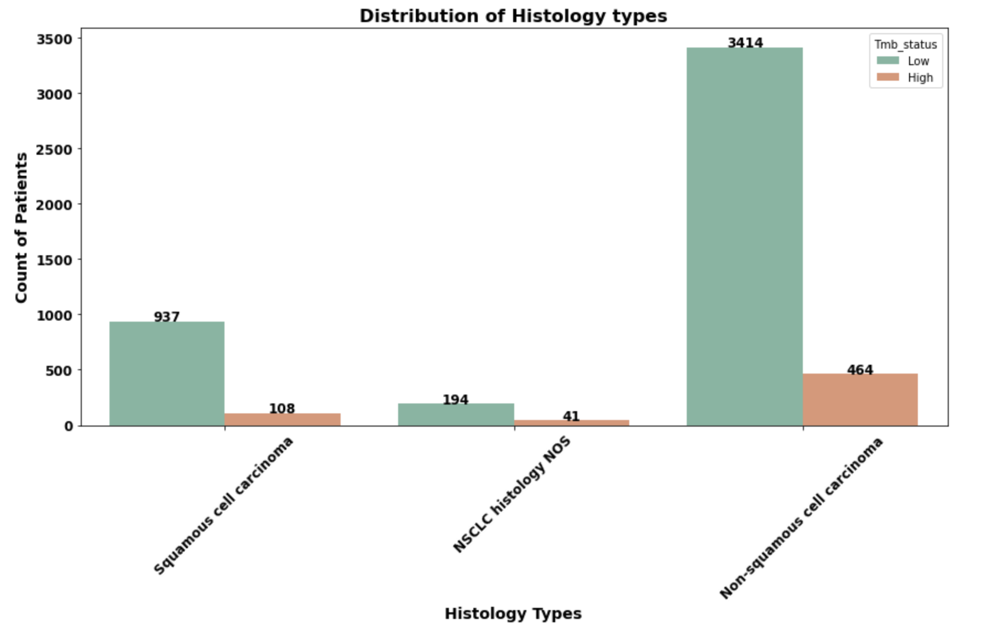
EDA | Bivariate Analysis – Histology vs Count of Patients
Insights
Non-squamous cell carcinoma is the most prevalent histology type: • Low TMB patients dominate with a count of 3414. • High TMB patients are fewer, with a count of 464.
Squamous cell carcinoma is the second most common histology type: • Low TMB patients count at 937, while High TMB patients are 108.
NSCLC histology NOS (Not Otherwise Specified) is the least represented category: • It has 194 Low TMB and 41 High TMB patients. .

Slide 12
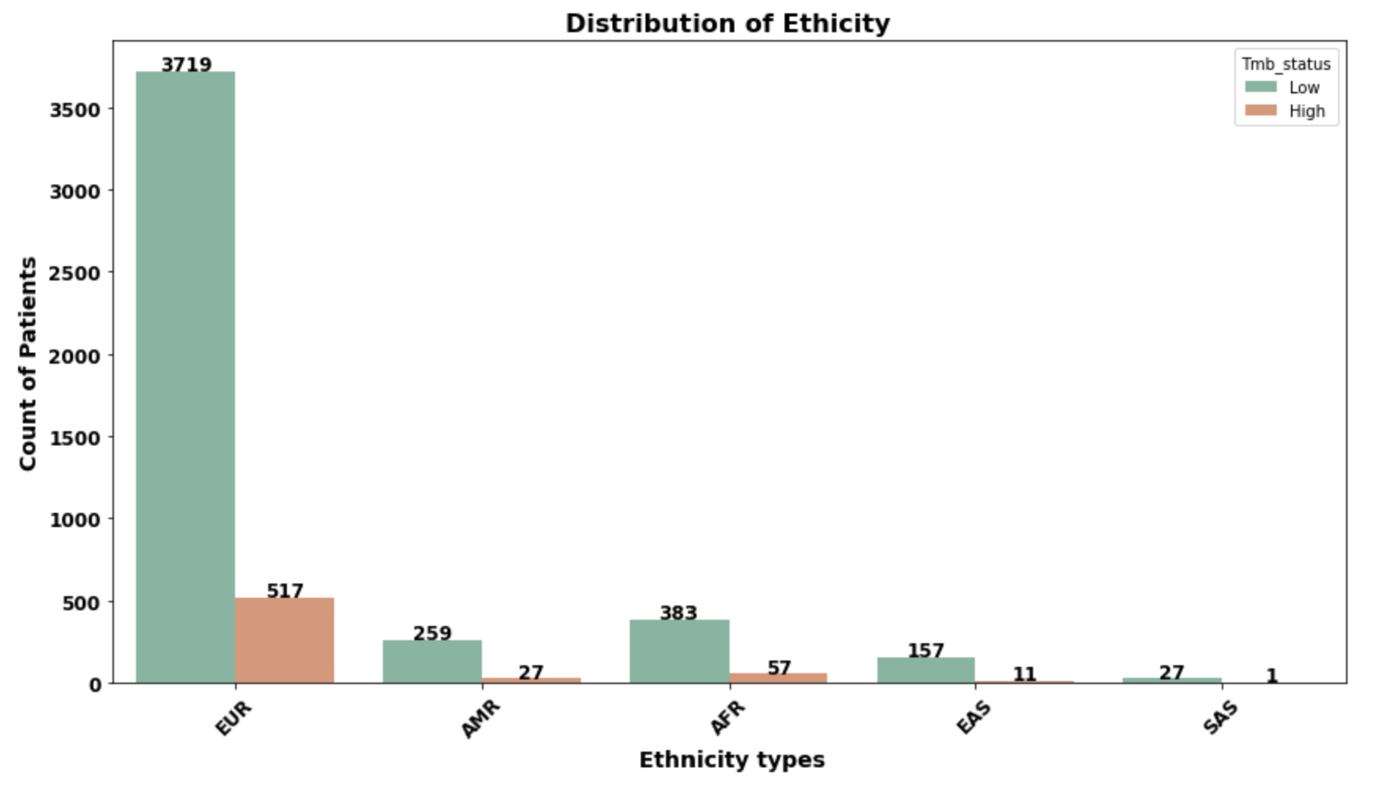
EDA | Bivariate Analysis – Ethnicity vs Count of Patients
Insights
EUR (European) ethnicity is the most represented: • Low TMB patients dominate, with a count of 3719. • High TMB patients are 517, which is significantly lower.
Other Ethnic Groups: • AMR (Americas): Low TMB patients are 259, while High TMB patients are 27. • AFR (African): Low TMB patients count at 383, and High TMB patients at 57. • EAS (East Asian): Low TMB patients are 157, and High TMB patients are 11. • SAS (South Asian): This group has the smallest representation, with 27 Low TMB and only 1 High TMB patient.
TMB Status Trend: • Across all ethnic groups, Low TMB patients outnumber High TMB patients, with EUR ethnicity showing the largest gap. .

Slide 13

DETAIL VIEW | Feature Selection and Model Execution
DATASET COLLECTION
EDA & FEATURE SELECTION
IMPORTANT FEATURES
EDA & FEATURE SELECTION
IDENTIFYING LEVEL
OF THE DATA
Group Stage
Practice Type
Gender
Age_idx
Biomarkers
Albumin
Hematocrit
Hemoglobin
Urea Nitrogen
Problem definition and hypothesis construction
Merged Data
Demographics
Analyzing the relevant data as features which can be used to test our hypothesis
Univariate Analysis
Bivariate Analysis
Multivariate Analysis
Lab Results
Biomarkers
Vital Signs
Datasets
Data Collection
Feature Engineering
Feature Selection
Model Execution

Slide 14
CLASSIFICATION | Models we considered
XGBoost is an optimized distributed gradient boosting library designed for efficient and scalable training of machine learning models.
Random Forest Classifier is a powerful ensemble learning algorithm used for classification tasks.
XG Boost
Random Forest Classifier
Cat Boost is designed for use on problems like regression and classification having a very large number of independent features.
Max Voting, Weighted Voting,
Stacking
Max Voting, Weighted Voting, and Stacking are ensemble learning techniques, where multiple models are combined to make a final prediction.
Cat Boost

Slide 15
Training – Testing Split
80 %
20 %
TRAINING SET
TEST SET
Why ?
How ?
Training Set: Used to train our model and learn patterns in the data.
Test Set: Helps us compare different models and tune hyperparameters to find the best-performing model.
Model Training: We trained three models using the training set.
Model Testing: We evaluated and compared model performances using the validation set to select the best one.

Slide 16
MODEL PERFORMANCE | Prediction of High TMB Status
Models Used: Random Forest, CatBoost, XGBoost, Ensembled (MaxVoting, StackedVoting)
Features | Accuracy | Precision | Recall | F1 Score
Random Forest Classifier | 93.3139 | 0.66 | 0.90 | 0.76
CatBoost | 93.5077 | 0.66 | 0.94 | 0.77
XGBoost | 93.4108 | 0.66 | 0.93 | 0.77
Max Voting | 93.4108 | 0.66 | 0.93 | 0.77
Stacked Voting | 93.1201 | 0.65 | 0.90 | 0.76

Slide 17
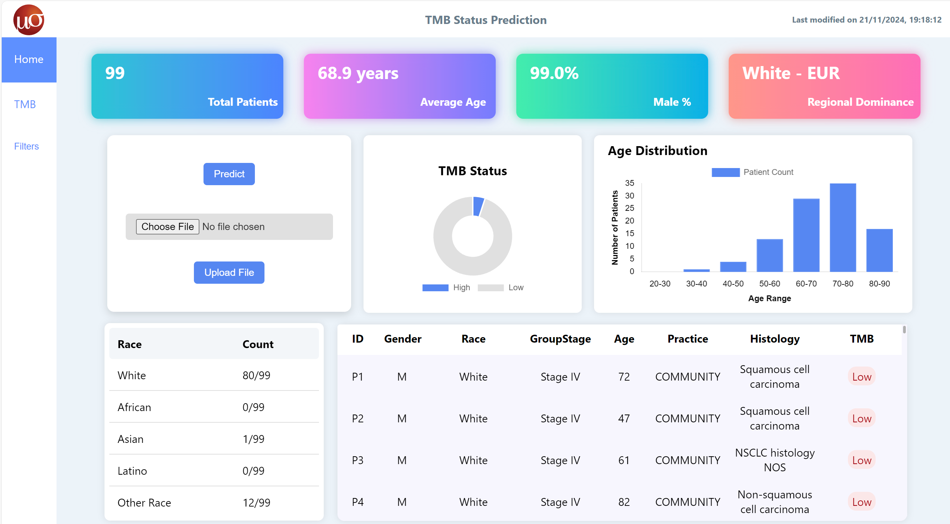
DASHBOARD WALKTHROUGH | TMB Status Prediction
Purpose: Provides an overview of patient demographics, TMB insights, and data-upload functionality for predictive analysis.

Slide 18
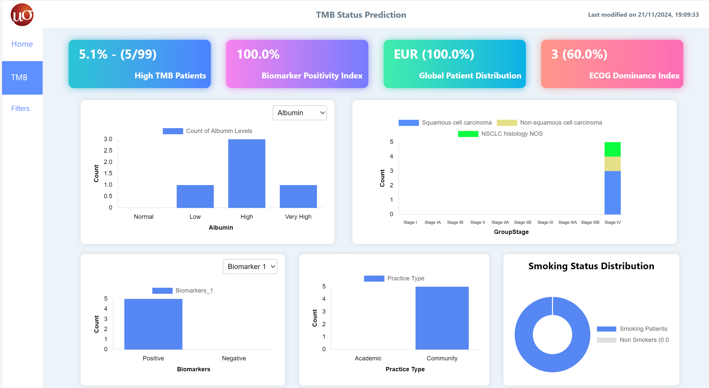
Purpose: This page serves as a bridge between data insights and actionable decisions, enabling stakeholders to derive clinical, research, and operational value from high TMB patient data.

Slide 19
Recommendations
Expand Predictive Model Capabilities
Develop multi-cancer predictive models to support a broader range of oncology applications.
Real-Time Decision Support
Integrate the predictive model into a real-time decision support system that assists cliniciansin identifying high TMB patients during consultations.
Automated Data Pipelines
Implement automated pipelines for data collection, preprocessing, and model retraining to reduce manual effort and ensure timely updates.
Integration with Genomic Data
Collaborate with genomic research teams to include whole-genome sequencing data, potentially improving model accuracy in identifying TMB.
Develop a Mobile Application
Create a mobile-friendly platform or app that allows the clinical team to easily access and use the predictive model on the go.
Incorporate Explainable AI (XAI)
Implement explainable AI techniques to make the model's predictions more interpretable for clinicians and regulatory compliance.

Slide 20
Thank You!

